Slide 1

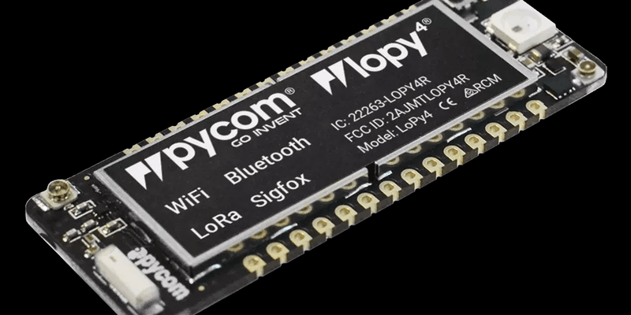
Lopy4 Prise en main
Jacques Chambon

Slide 2
Agenda (à confirmer)
Jeudi 11/04 : Lopy4 (Jacques Chambon)
mardi 23/04 : Lora/Sigfox sur Lopy4 (Remi Jolin)
mercredi 24/04 : The Things Network (TTN) (Fabien Ferrero)
Jeudi 25/04 : Présentation Busit (Guillaume Meriel)
vendredi 26/04 : Propriété Intellectuelle (Benjamin Delsol)

Slide 3
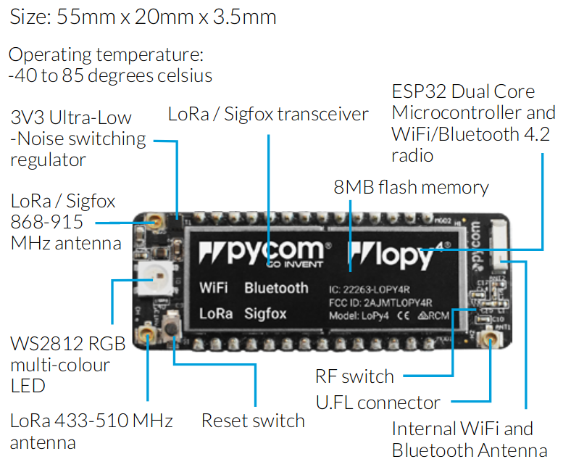

Slide 4
Powerful CPU, BLE and state of the art WiFi radio
Can also double up as Nano LoRa gateway
MicroPython enabled
Fits in a standard breadboard (with headers)
Ultra-low power usage: a fraction compared to other connected micro controllers

Slide 5
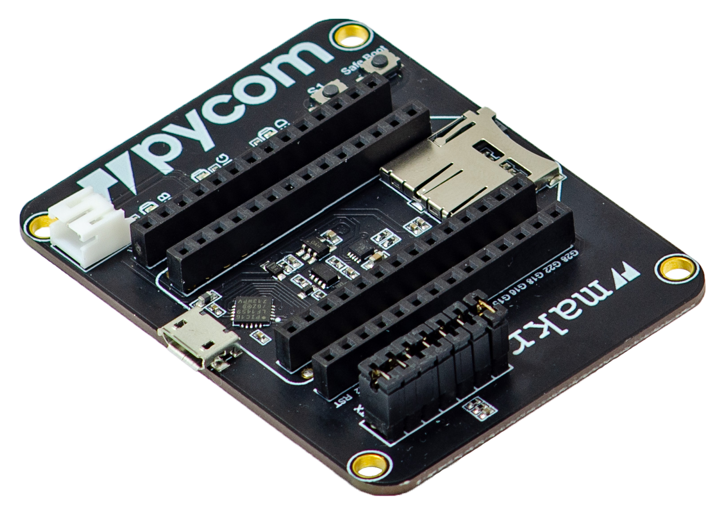

Slide 6
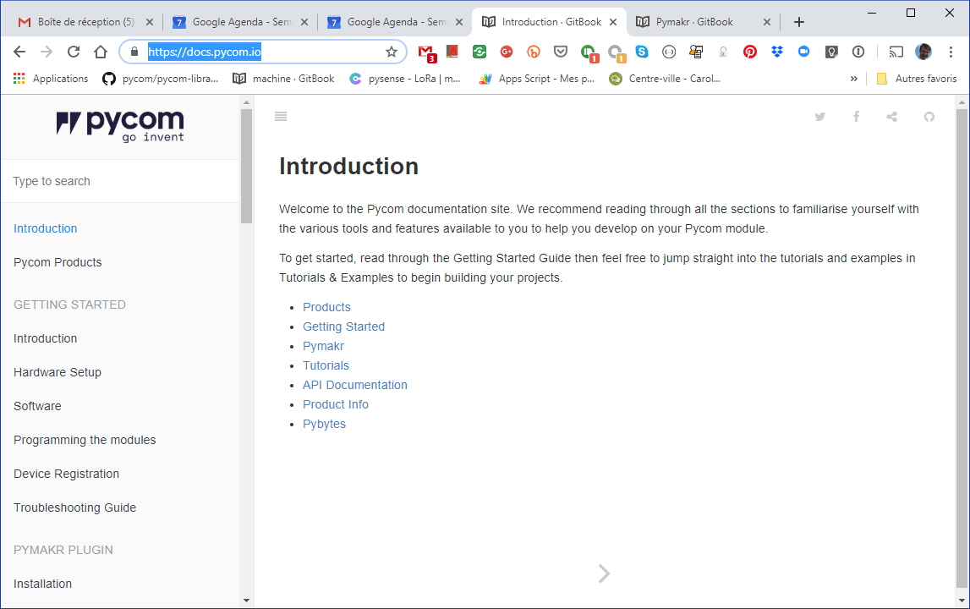
Documentation

Slide 7
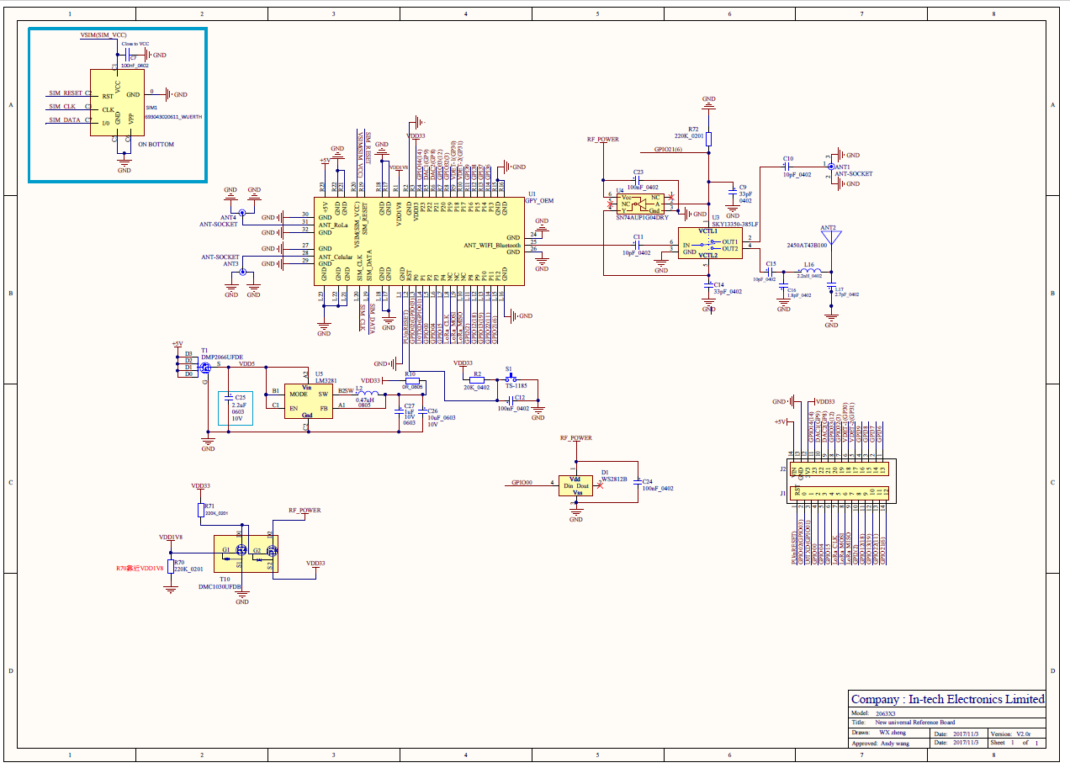

Slide 8
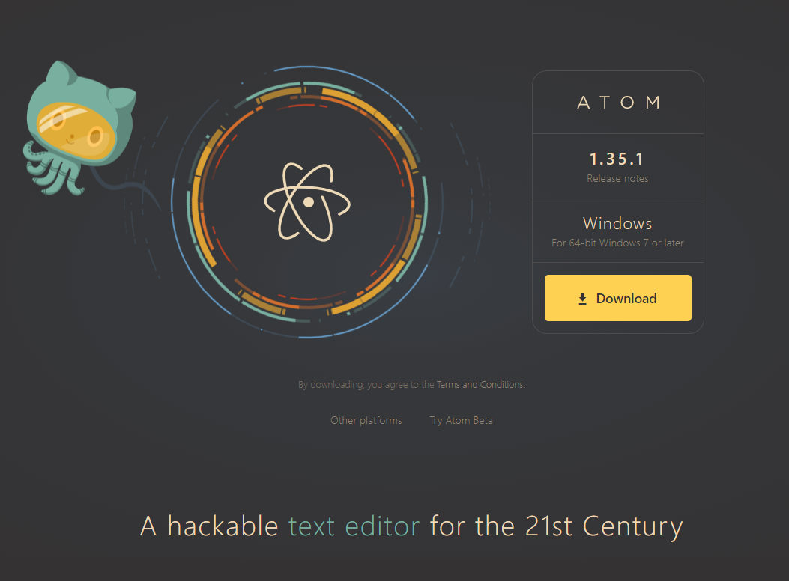

https://atom.io/
https://github.com/pycom/pymakr-atom/

Slide 9
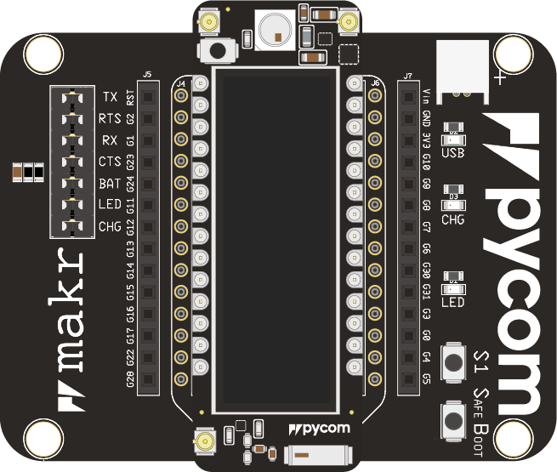

Slide 10
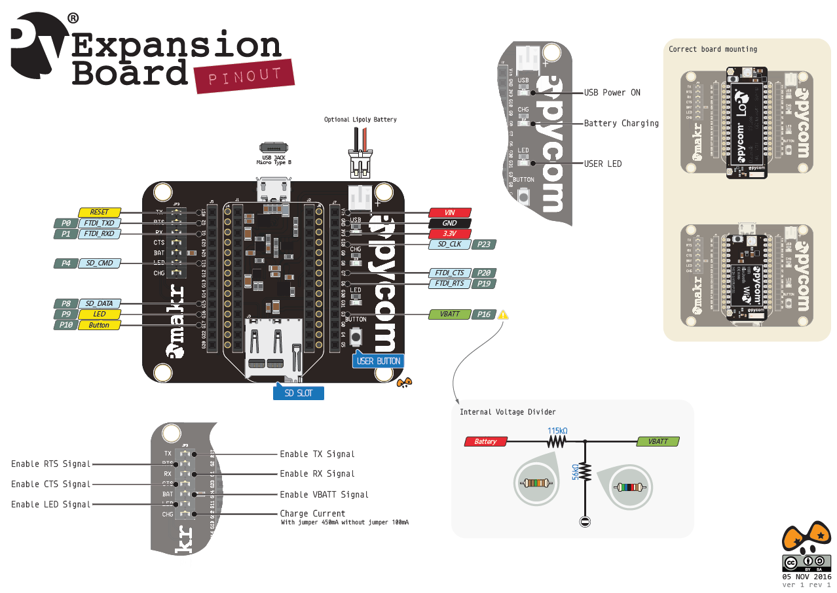
https://docs.pycom.io/.gitbook/assets/expansion2-pinout.pdf

Slide 11
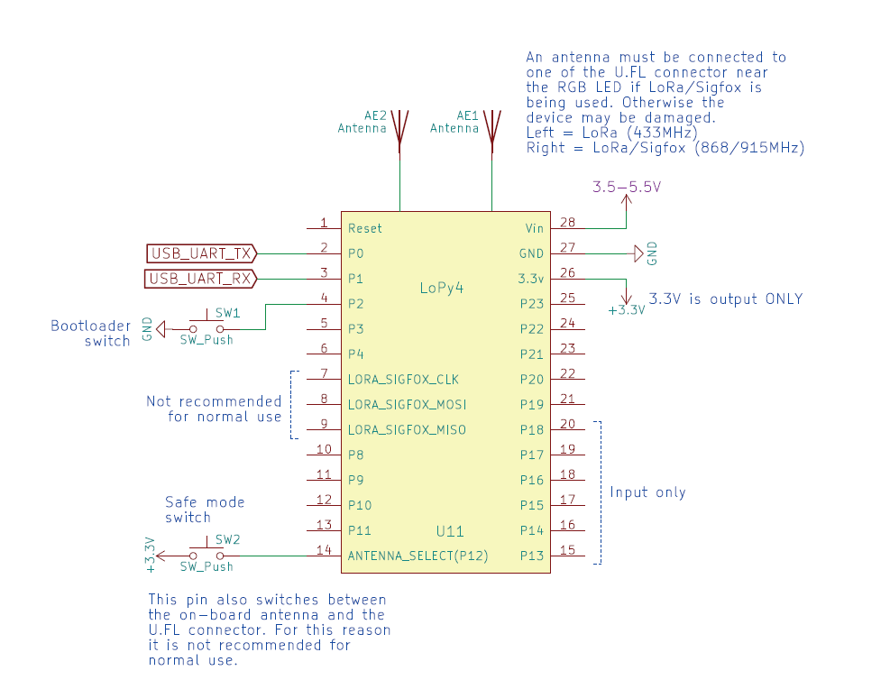

Slide 12
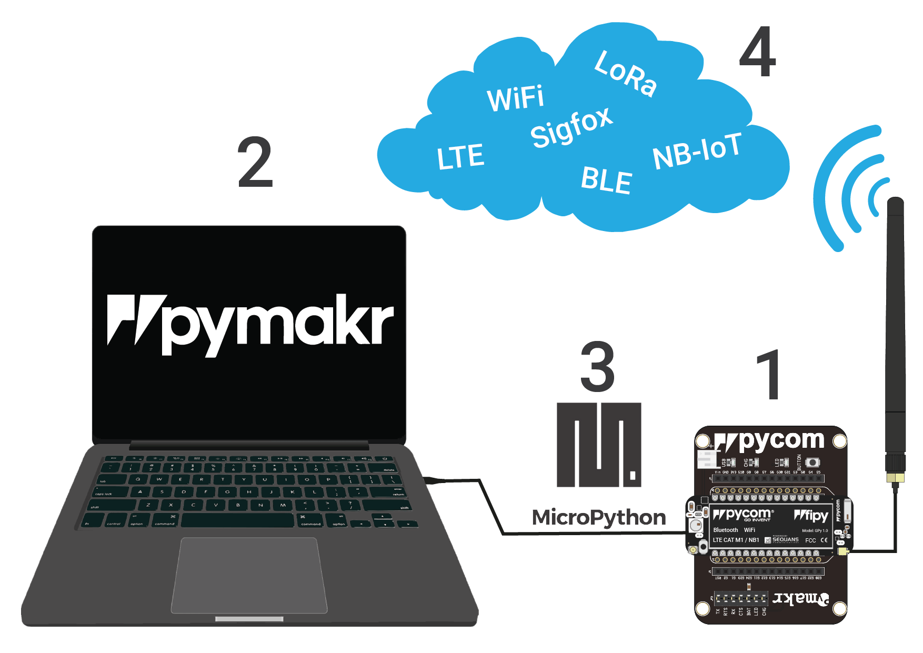

Slide 13
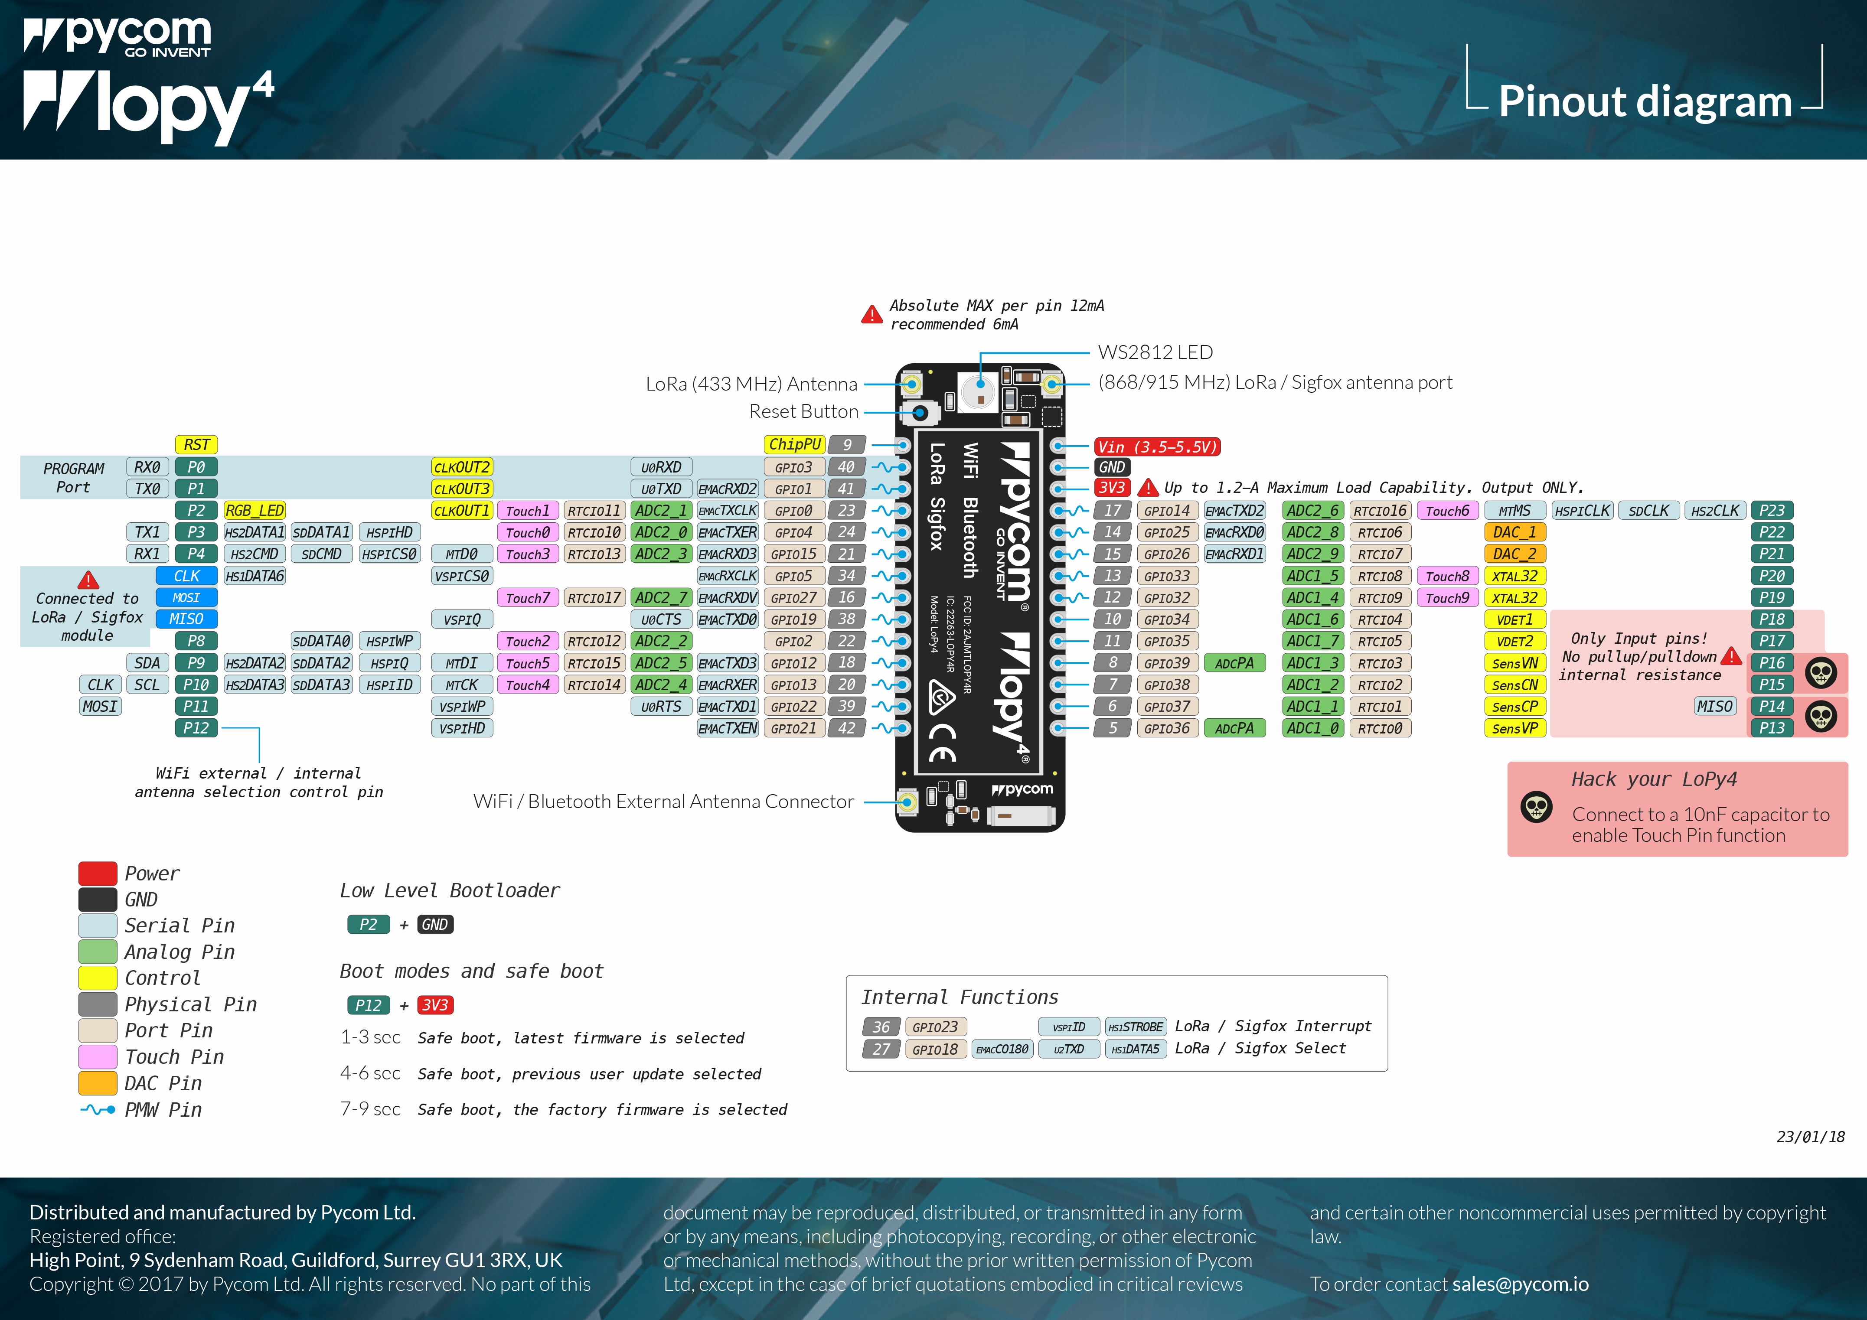

Slide 14
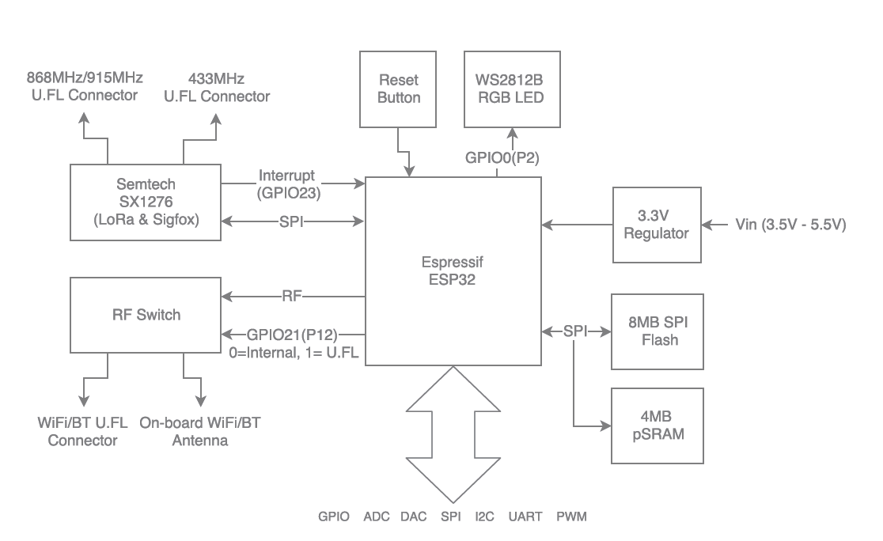

Slide 15
